Slide 2









Who am I?
Tester
Test Developer
Consultant
Test Manager
Developer
Manager
Project Lead
Writer…
Struggling...
Failed

Slide 3

Enhancing Your Testing Powers
1
Testing Capabilities
2
Testability
3
Testing Skills
Development knowledge
Build testability and observability into code
Expand your tool belt as a tester

Slide 4

Test Automation Mountain of
Doom

Slide 5

Collaborating with Developers
1
Open communication with the team is key.
2
Seek feedback from experienced developers to get their advice.
3
By working closely with developers, you can help cultivate a culture of testing in the team.
4
And don’t forget the AI these days!

Slide 6




Practical Coding Demo
Django Application
Back-end REST API
Create Test Data
Through API endpoint
Demo Result
Streamlined test data generation

Slide 7

General Technical Awareness
Broad Knowledge
Right Questions
Expertise Optional
Broad technical understanding
Ability to ask questions
Deep specialization not required

Slide 8




Adding Logging To Our Code
Python Code
Add Logging
Demo Result
Starting application code
Enhance debugging observability
Improved code visibility

Slide 9


Examples of Skills
Git / Version Control
CI System Knowledge
Programming Skills
Technical Knowledge
Bash / Shell Scripting
Python for Tools
Networks & Comm
Databases
SSH – Public/Private keys
HTML & DOM
...

Slide 10

Practical Coding Demo
1
Multiple Log Files
Open and monitor logs
2
Python Data Digger
Search for keywords
3
Demo Result
Streamlined log analysis

Slide 11
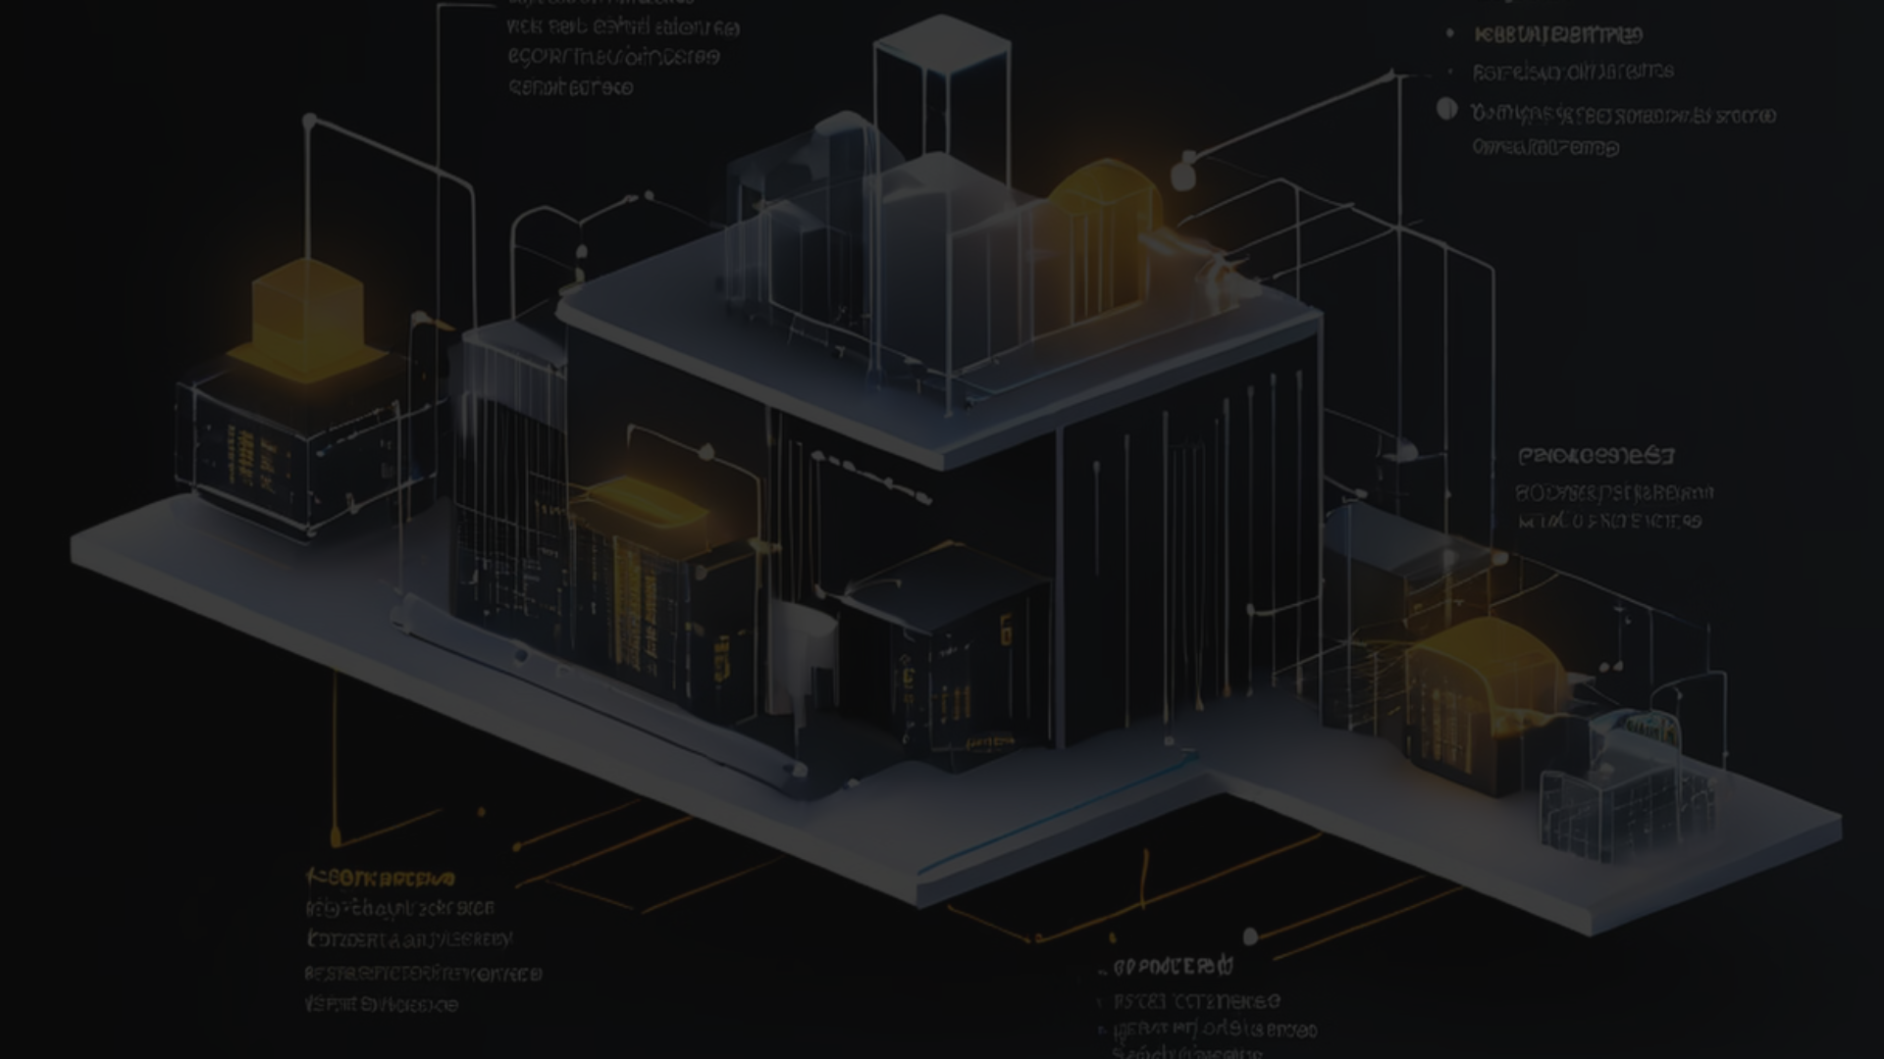
Enabling Testability
Simple Implementations
Kernel Instrumentation
Collaboration
Work with developers, architects
Additions can often be straightforward
Even complex tasks simplified

Slide 12

Practical Coding Demo
1
Production Code
Original file system calls
2
Test Case Hook
LD_PRELOAD override
3
User Space / Kernel Module
Override getdents() syscall
4
Demo Result
Controllable file system behavior

Slide 13

Key Takeaways
1
Embrace Learning
2
Stay Curious
Continuous growth mindset
Seek new knowledge
3
Gather Knowledge
Broad or specialized skills

Slide 14
Questions?
Email kristoffer.nordstrom@northerntest.se
Social @kristoffer_nordstrom@sw-development-is.social

